Slide 1
Web Application for Training and Placement Cell
B. Vamsi – 189X5A05K3
G. Abhishek – 179X1A05B3
Shaik Ashfaq – 179X1A05F7
Under the guidance of Sri. P. Praveen Yadav

Slide 2
ABSTRACT :
This project is aimed at developing a web application for the Training and Placement cell of the college. This system can be used as an application for the TPO of the college to manage the student information with regards to placement. Students can also be able to share their interview experiences and suggestions for next upcoming batches to crack their recruitment test and interviews. And also present students in college can also be able to search for the past interview feedbacks.

Slide 3
OBJECTIVE :
The primary objective of the application for Training and Placement Cell is to reduce the work-load of the TPO’s who has to maintain all the records in a excel sheets which becomes to search and maintain which is very time consuming as well as very hectic.
Our project provides the facility of maintaining the details of the students and collects the all interview feedbacks for upcoming batches recruitments.

Slide 4
Technologies Used :
This project is a web application that is developed in PHP, HTML ( including web technology such as CSS) having Xampp server as local database server.
Coding : PHP
Input Design : HTML, CSS
Database Server : Xampp

Slide 5
ANALYSIS :
During analysis data is collected on the various files.
The detailed studies carried out to check the work ability of proposed system.
Chances of mistake due to large amount of information.
Too much time required for maintaining records.

Slide 6
DFD CONTEXT LEVEL
Admin
T&P
Feedback

Slide 7
DFD LEVEL – 1 (FEEDBACK)
Submit a feedback
Feedback
Search for feedback

Slide 8

DFD LEVEL – 2 (ADMIN)
Add a Student
Update a Student
Admin
Delete feedback response
View all Student details
View all feedback

Slide 9
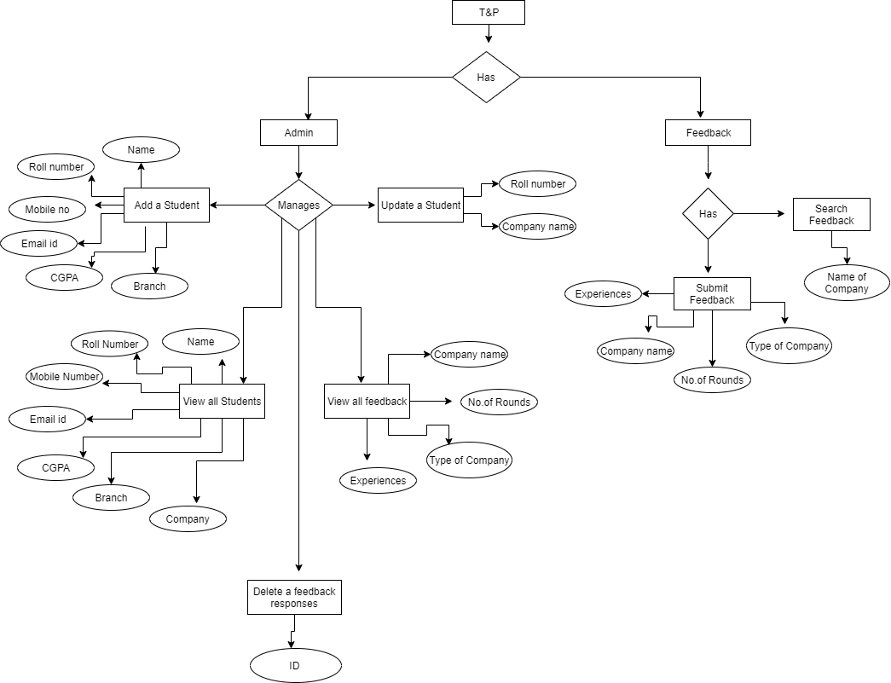
Entity Relationship Diagram

Slide 10

Welcome Page

Slide 11
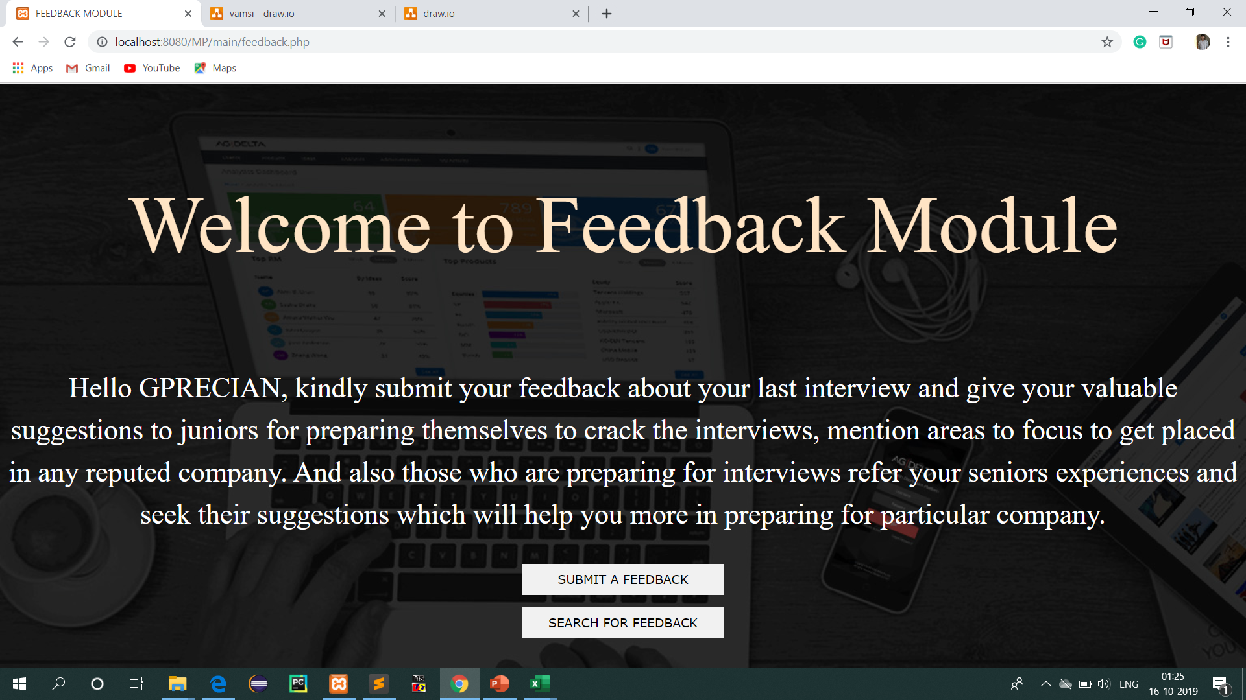
Feedback Module page

Slide 12
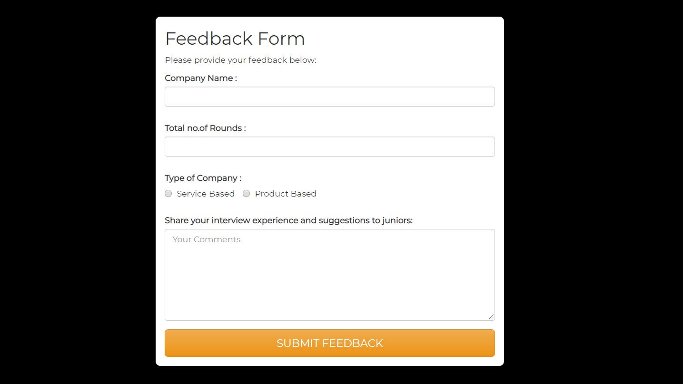
Feedback Submit

Slide 13
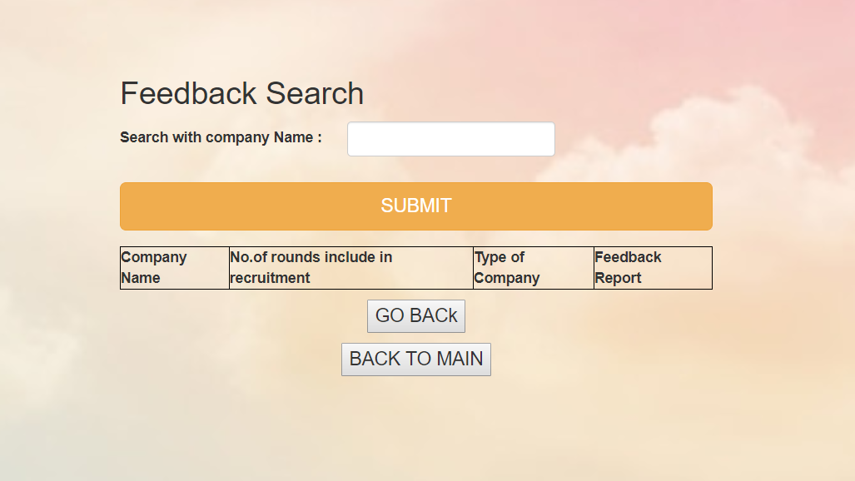
Feedback Search

Slide 14
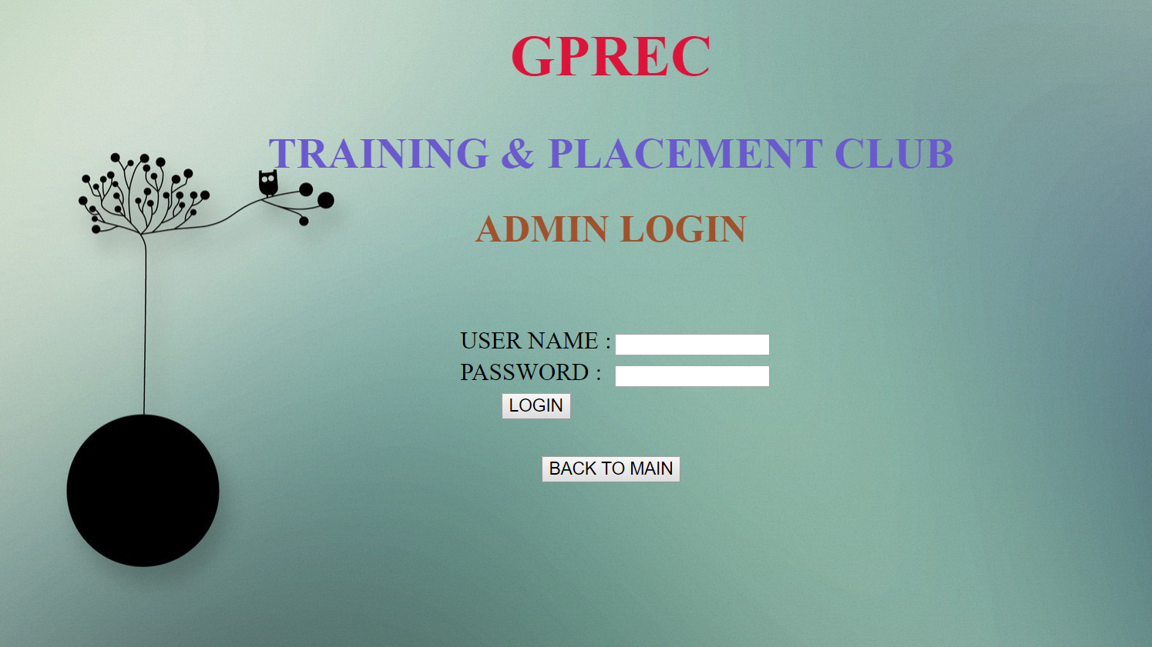
Admin Login

Slide 15
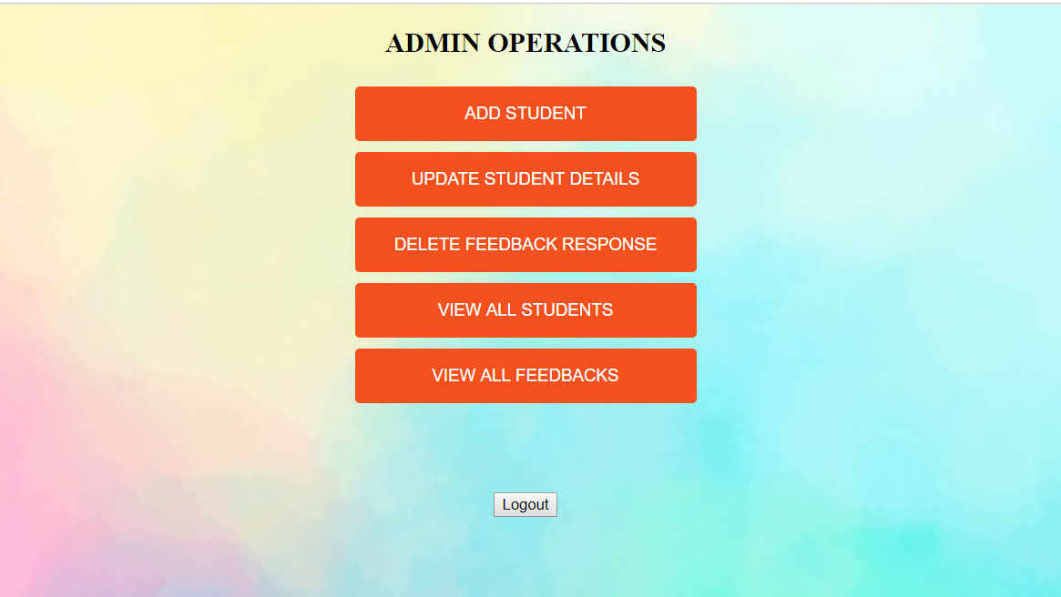
Admin Operations :

Slide 16
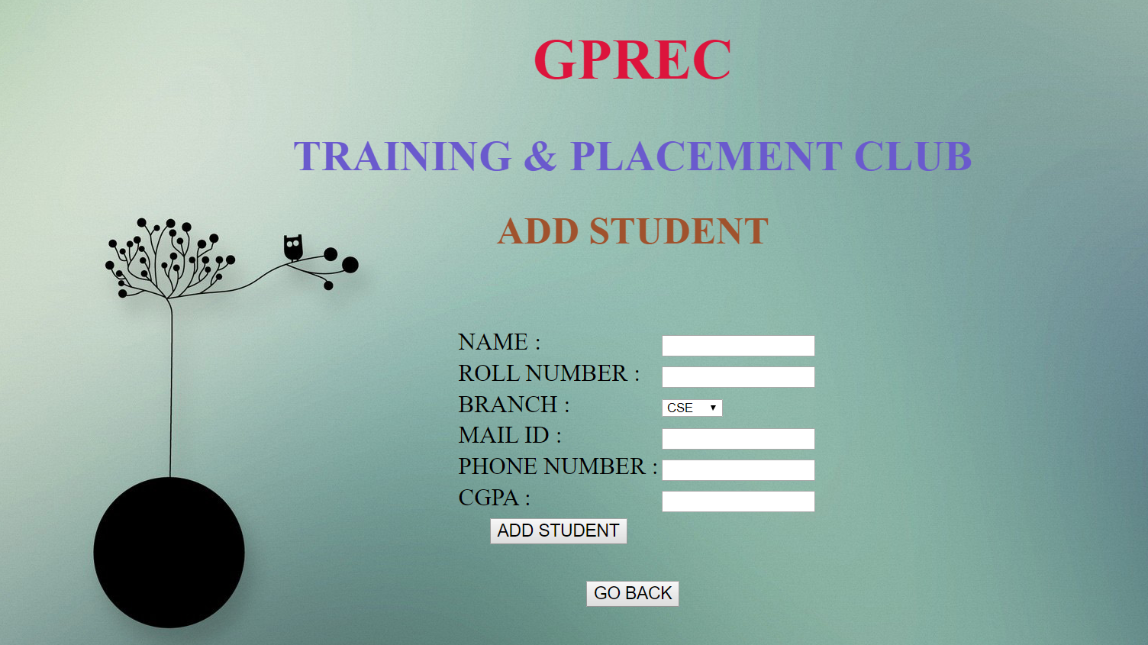
Adding a student

Slide 17
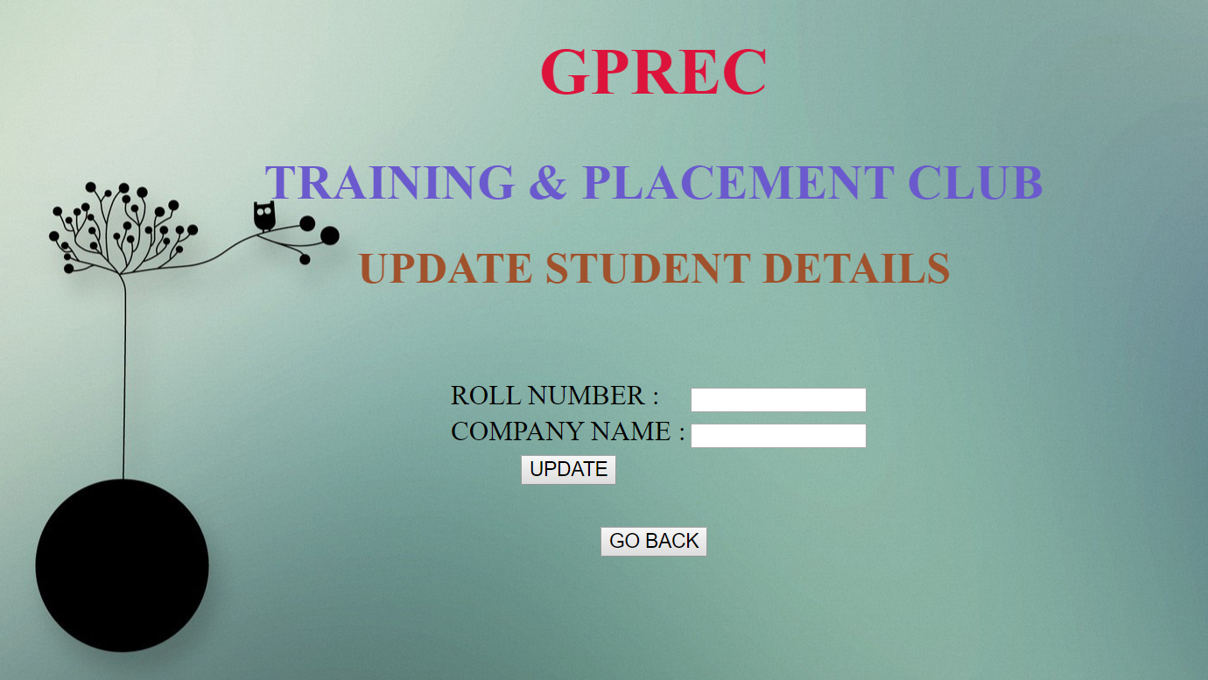
Update student details

Slide 18
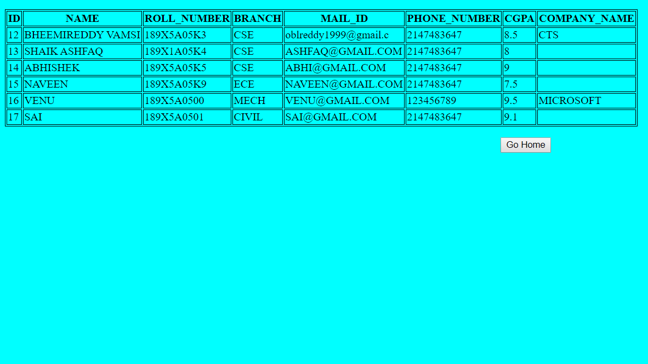
View all student data (Output)

Slide 19
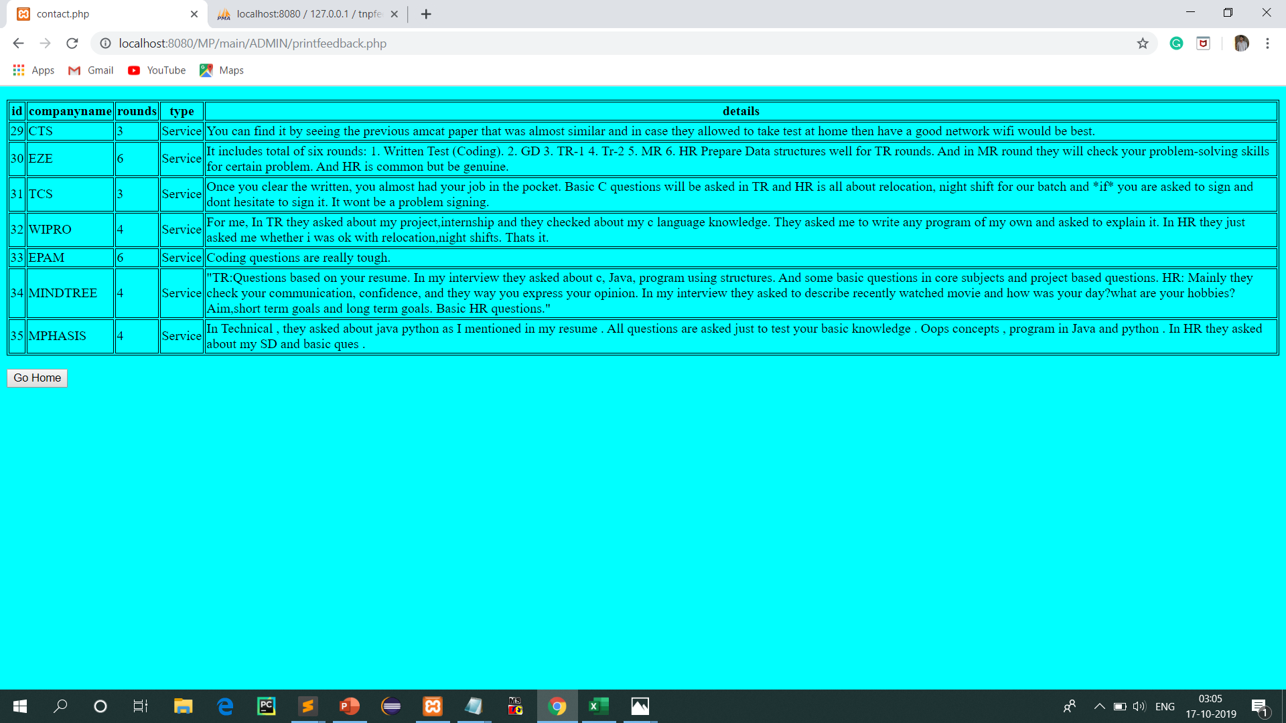
View all feedback data (Output)

Slide 20
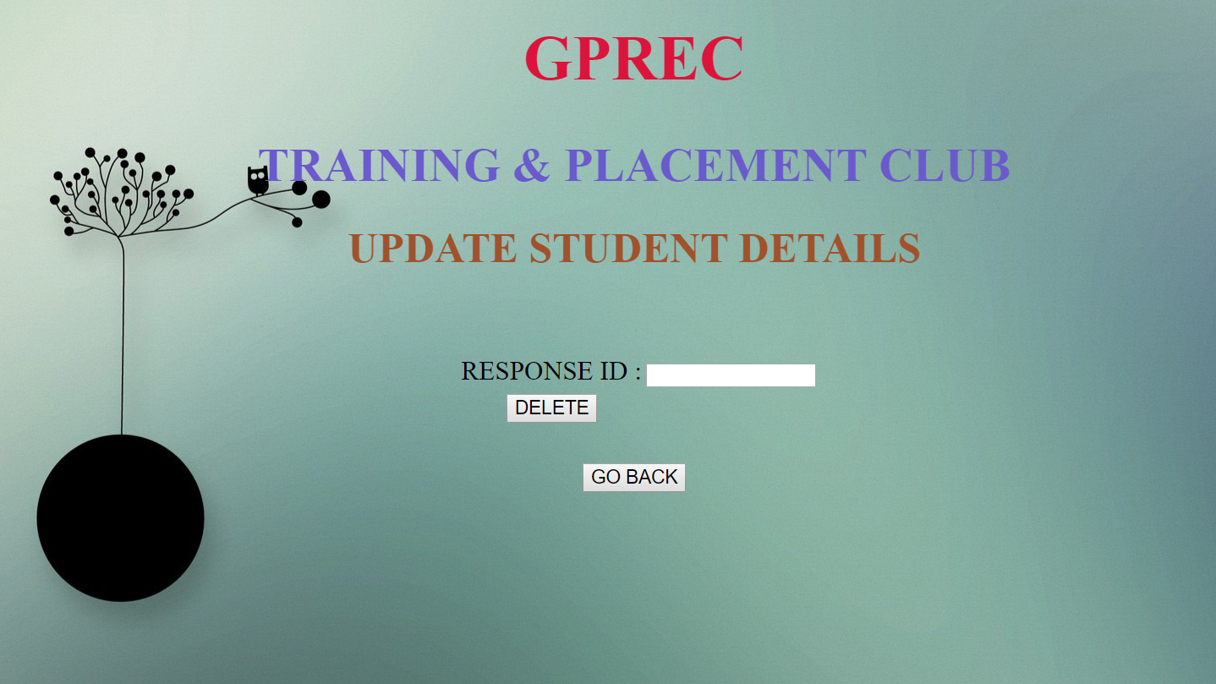
Deleting Feedback Response :

Slide 21
Testing :
For the purpose of testing our project, we are using following methods of testing :
White Box Testing and
Black Box Testing

Slide 22
Future extension of project :
By using the Google Cloud Platform or any other cloud databases for storing and it can be accessed through out college.
And then we can place this is as a official website for Training and Placement cell of college by modifying the entire project by gathering all the requirements from the TPO.
And also we can include information about upcoming drives and ITCA training updates in website.
And also we can collect all the resumes of the students and places it has a references for the upcoming students.

Slide 23
Conclusion :
From a proper analysis of positive points and constraints on the component, it can be safely concluded that the product is a highly efficient GUI based component.
This all information has to be managed manually. So, there is a need to develop a system that can solve the mentioned problem. This software are comes with just that solutions.

Slide 24


